Slide 1

Artificial Intelligence
Problem Solving by searching
CS-632
Dr. Muhammad Aqib
University Institute of Information Technology
PMAS-Arid Agriculture University Rawalpindi

Slide 2
Problem solving agent
A kind of Goal-based agent.
Decide what to do by searching sequences of actions that lead to desirable states.

Slide 3
Problem Definition
Initial state : starting point
Operator: description of an action
State space: set of all states reachable from the initial state by any sequence of actions.
Path: sequence of actions leading from one state to another
Goal test: which the agent can apply to a single state description to determine if it is a goal state
Path cost function: assign a cost to a path which is the sum of the costs of the individual actions along the path.

Slide 4
What is Search?
Search is the systematic examination of states to find path from the start/root state to the goal state.
The set of possible states, together with operators defining their connectivity in the search space.
The output of a search algorithm is a solution, that is, a path from the initial state to a state that satisfies the goal test.
In real life search usually results from a lack of knowledge. In AI too search is merely an offensive instrument with which to attack problems that we can't seem to solve any better way.

Slide 5
Goal-formulation
What is the goal state?
What are important characteristics of the goal state?
How does the agent know that it has reached the goal?
Are there several possible goal states?
Are they equal or are some more preferable?
Courtesy: Dr. Franz J. Kurfess

Slide 6
Goal
We will consider a goal to be a set of world states – just those states in which the goal is satisfied.
Actions can be viewed as causing transitions between world states.

Slide 7
Looking for Parking
Going home; need to find street parking
Formulate Goal:
Car is parked
Formulate Problem:
States: street with parking and car at that street
Actions: drive between street segments
Find solution:
Sequence of street segments, ending with a street with parking

Slide 8
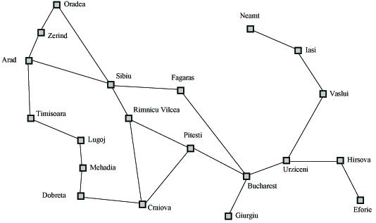
Search Example
Formulate goal: Be in Bucharest.
Formulate problem: states are cities, operators drive between pairs of cities
Find solution: Find a sequence of cities (e.g., Arad, Sibiu, Fagaras, Bucharest) that leads from the current state to a state meeting the goal condition

Slide 9
Problem Formulation
A search problem is defined by the
Initial state (e.g., Arad)
Operators (e.g., Arad -> Zerind, Arad -> Sibiu, etc.)
Goal test (e.g., at Bucharest)
Solution cost (e.g., path cost)

Slide 10
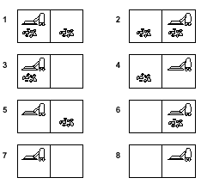
Vacuum World
8 possible world states
3 possible actions: Left/Right/ Suck
Goal: clean up all the dirt= state(7) or state(8)

Slide 11
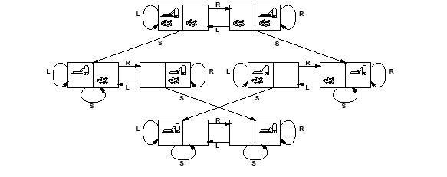
Vacuum World
S₁
S₂
S₃
S₆
S₅
S₄
S₇
S₈
States: S₁ , S₂ , S₃ , S₄ , S₅ , S₆ , S₇ , S₈
Operators: Go Left , Go Right , Suck
Goal test: no dirt left in both squares
Path Cost: each action costs 1.

Slide 12
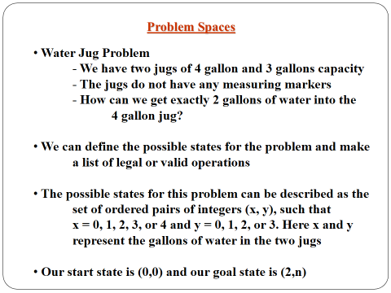

Slide 13
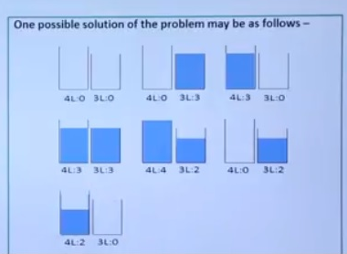
Water Jug Problem

Slide 14
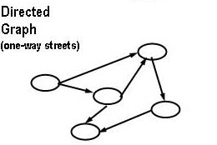
Directed graphs
A graph is also a set of nodes connected by links but where loops are allowed, and a node can have multiple parents.
We have two kinds of graphs to deal with: directed graphs, where the links have direction (one-way streets).

Slide 15
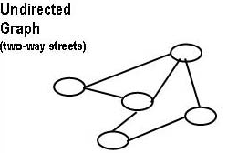
Undirected graphs
Undirected graphs where the links go both ways. You can think of an undirected graph as shorthand for a graph with directed links going each way between connected nodes.

Slide 16
Goal Directed Agent
A goal directed agent needs to achieve certain goals.
Such an agent selects its actions based on the goal it has.
Many problems can be represented as
a set of states and
a set of rules of how one state is transformed to another.

Slide 17
Search Problem
A search problem consists of the following:
S: the full set of states
S0 : the initial state
A:S→S is a set of operators
G is the set of final states. Note that G ⊆S

Slide 18
Search Problem
The search problem is to find a sequence of actions which transforms the agent from the initial state to a goal state g∈G

Slide 19
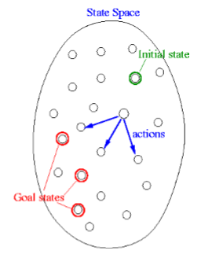
State space representation

Slide 20
Representation of search problems
A search problem is represented using a directed graph.
The states are represented as nodes.
The allowed actions are represented as arcs.

Slide 21
Searching process
The generic searching process can be very simply described in terms of the following steps:
Do until a solution is found or the state space is exhausted.
Check the current state
Execute allowable actions to find the successor states.
Pick one of the new states.
Check if the new state is a solution state. If it is not, the new state becomes the current state, and the process is repeated.

Slide 22
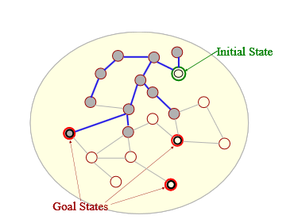
Illustration of a search process

Slide 23
Example problem Pegs and Disks problem
Consider the following problem.
We have 3 pegs and 3 disks.
Operators: one may move the topmost disk on any needle to the topmost position to any other needle.

Slide 24
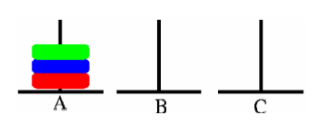
Initial state

Slide 25
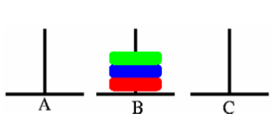
Goal state

Slide 26
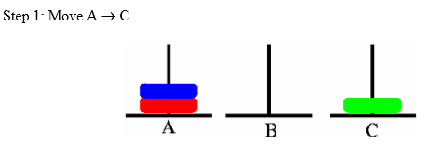
Sequence of actions

Slide 27
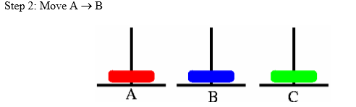
Sequence of actions

Slide 28
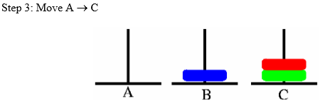
Sequence of actions

Slide 29
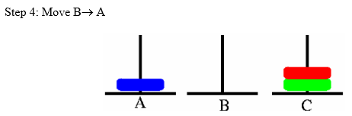
Sequence of actions

Slide 30
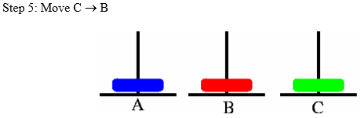
Sequence of actions

Slide 31
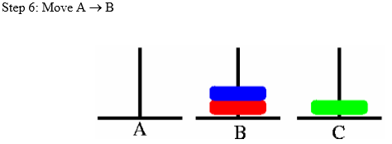
Sequence of actions

Slide 32
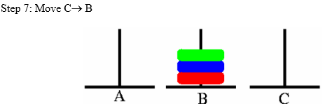
Sequence of actions

Slide 33
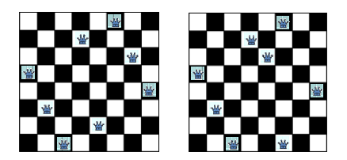
8 queens problem
The problem is to place 8 queens on a chessboard so that no two queens are in the same row, column or diagonal
The picture on the left shows a solution of the 8-queens problem. The picture on the right is not a correct solution, because some of the queens are attacking each other.

Slide 34
N queens problem formulation
Problem formulation
Deciding the representation of the states
Selecting the initial state representation
The description of the operators, and the successor states
We can formulate the search problem in several different ways for this problem.

Slide 35
N queens problem formulation
N queens problem formulation 1
States: Any arrangement of 0 to 8 queens on the board
Initial state: 0 queens on the board
Successor function: Add a queen in any square
Goal test: 8 queens on the board, none are attacked

Slide 36
N queens problem formulation 1
The initial state has 64 successors.
Each of the states at the next level have 63 successors, and so on.
We can restrict the search tree somewhat by considering only those successors where no queen is attacking each other. To do that we have to check the new queen against all existing queens on the board.

Slide 37
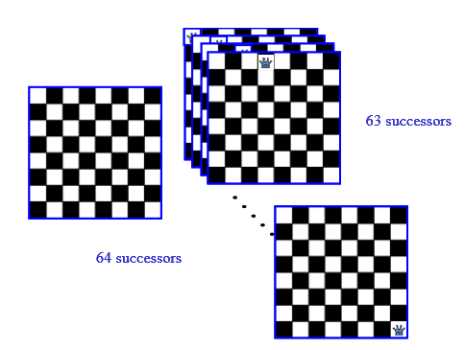
N queens problem formulation 1

Slide 38
N queens problem formulation 2
States:
Any arrangement of 8 queens on the board
Initial state:
All queens are at column 1
Successor function:
Change the position of any one queen
Goal test:
8 queens on the board, none are attacked
If we consider moving the queen at column 1, it may move to any of the seven remaining columns.

Slide 39
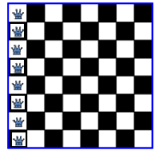
N queens problem formulation 2

Slide 40
N queens problem formulation 3
States:
Any arrangement of k queens in the first k rows such that none are attacked
Initial state:
0 queens on the board
Successor function:
Add a queen to the (k+1)th row so that none are attacked.
Goal test :
8 queens on the board, none are attacked

Slide 41
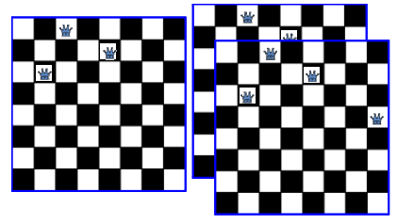
N queens problem formulation 3

Slide 42
Thank You

